Slide 1

DriverPass System Analysis
Corey Peterson

Slide 2

System Requirements
Non-functional Requirements
Performance
Security
Functional Requirements
The system should allow customers to create and manage accounts.
The system should allow customers to schedule and manage driving lessons.
Notes:
This slide is about the 'rules' for the DriverPass system. I have divided them into two groups: what the system does and how well it does it.
First, the ‘what’ is the functional requirements. The system will let students create and manage their accounts. This means signing up, changing info, and so on. It’ll also let them schedule and manage their driving lessons – book times, change appointments. These are the core actions the system must perform.
Then, the 'how well' – the Non-functional Requirements. We're focusing on Performance, meaning the system needs to be fast and responsive, so there's no waiting around.
Security is vital to protect student data, such as names and contact information. So, these 'rules' ensure the system performs effectively and reliably.

Slide 3
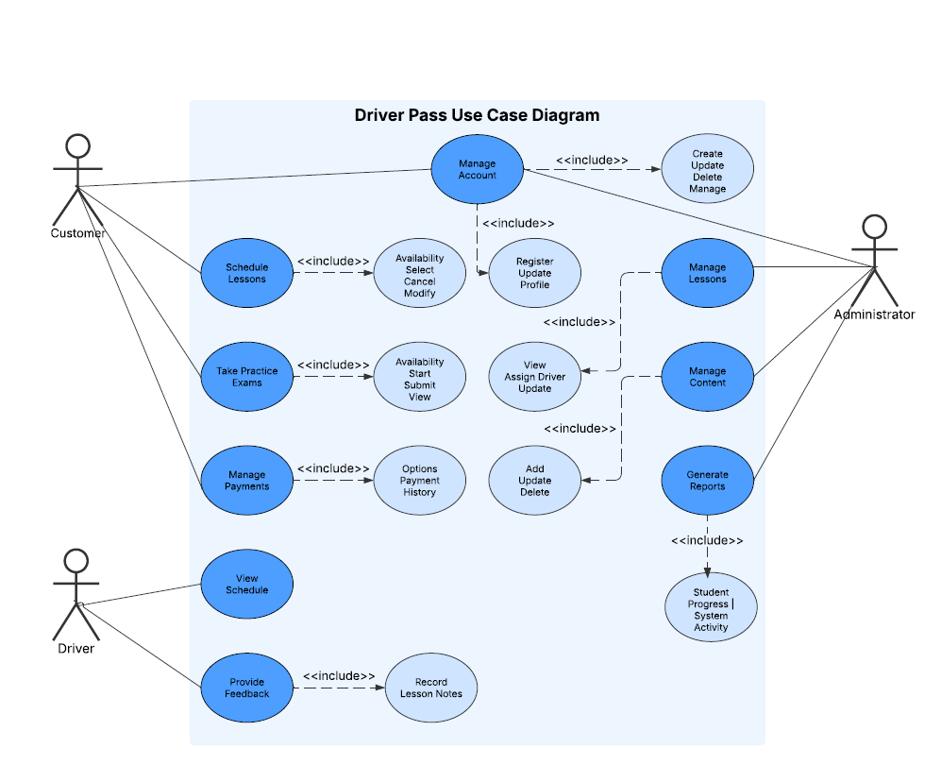
Use Case Diagram
Notes:
This diagram shows all the different things users can do with the system.
It’s like a flowchart of the system’s functions.
Customers are the students who want to learn to drive.
Administrators are the Driver Pass staff who manage the system.
Drivers are the driving instructors.
The circles in the diagram represent the different tasks each person can perform. For example, Customers can "Schedule Lessons," "Take Practice Exams," and "Manage Payments.“ Administrators can "Manage Accounts" and "Manage Lessons.“ Drivers can "View Schedule" and "Provide Feedback.“
The lines show which people do what. For example, a line between "Customer" and "Schedule Lessons" means customers can schedule lessons.
Some of the lines have “<<include>>" written on them. This means that one task is part of another. For example, "Register" is included in "Manage Account," because you have to register to manage your account.

Slide 4
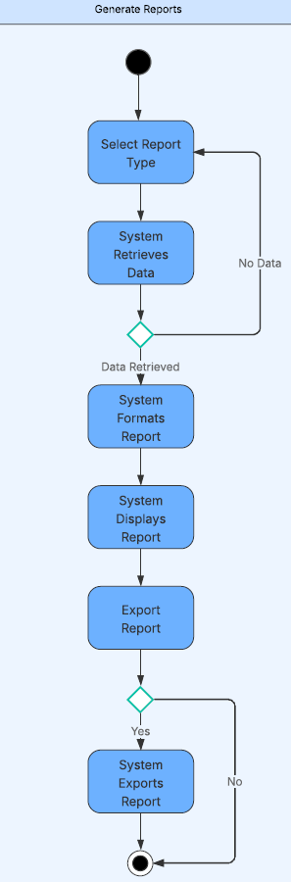
Activity Diagram
Notes:
This slide shows a diagram that outlines the steps involved when a DriverPass administrator creates a report. Think of it as a recipe for generating a report.
Here's how the process works:
It starts with the administrator choosing what type of report they want to see. This could be a report on student progress, revenue, or system activity.
Then, the system gathers all the necessary information to create that report.
The system checks if it has found any information.
If it didn't find anything, it goes back to the beginning, and the administrator might need to choose a different report type or adjust their search.
If the system does find information, it formats it into a readable report, like putting it into a table or chart.
Next, the system shows the formatted report to the administrator.
Finally, the administrator has the option to export the report – that is, save it in a different format like a PDF or spreadsheet. If they choose to do that, the system exports the report. If not, the process ends.
This type of diagram shows all the steps the system takes, from the moment an administrator asks for a report to the moment they receive it, making sure it handles situations where there might not be any information available.

Slide 5
Security
User Login Requirements
Secure Connection & Data Exchange
Mitigate Brute-Force Hacking Attempts
Secure Password Recovery
Notes:
Security is a top priority for the DriverPass system. We're taking several steps to make sure everyone's information is safe.
First, we have User Login Requirements. This is how we control who can access the system. We'll need strong passwords – think of them as secret codes – and maybe even extra steps like sending a code to your phone, so only the right person gets in.
Next is Secure Connection & Data Exchange. This means that when information is sent between your computer or phone and the DriverPass system, it's scrambled up so no one can read it if they intercept it. Like having a secret conversation that no one else can understand.
We're also thinking about how to Mitigate Brute-Force Hacking Attempts. This is when someone tries to guess your password by trying many combinations. We'll have systems in place to lock accounts after too many wrong tries, so they can't just keep guessing.
Finally, we'll have Secure Password Recovery. If you forget your password, we'll have a safe way for you to get it back, like sending a reset link to your email, so only you can change it.
All these security measures are like locks and alarms for the system, protecting everyone's information and ensuring only authorized people can access it.

Slide 6
System Limitations
The initial version of the system may have limitations in terms of advanced features, such as:
Integration with other educational platforms.
Highly customized reporting and analytics.
Advanced user personalization options.
The system's functionality may be limited by the availability and accuracy of data provided by external sources, such as those from the DMV (Southern New Hampshire University, 2025).
The system's performance may be limited by the capacity of the hosting environment and the efficiency of the database design (Dennis, Wixom, & Tegarden, 2015).
Notes:
It's important to be realistic about what our system can and can't do, especially in its initial stages. So, let's talk about some limitations.
First, the early version might not have all the bells and whistles.
For example:
It might not connect with other learning websites or platforms.
The reporting and analytics might be pretty basic, not highly detailed.
We might not have many options for students to personalize their experience, like choosing a specific look or feel for their account.
Second, the system's accuracy depends on the information we get from outside sources, especially the DMV. If they have delays or changes, our system will be affected. So, we're relying on them to keep us updated.
Finally, the system's speed and performance could be limited by how powerful the computers and servers are that it runs on, and how efficiently we've designed the way the information is stored and accessed.
Think of it like a website that can get slow if too many people use it at once, or if it's not built well.
These limitations are just things to be aware of. We'll work to address them as the system develops, but it's good to be upfront about them from the start.

